Slide 1
Updates 9/4/15
Three issues
HPC tracking of V(BestUnchosen): positive or negative?
V(Best Unchosen) split into positive/negative, but negative V(BU)s are all rejected
Choice model: what can be concluded about Choice after controlling for e.g. pLoss?

Slide 2
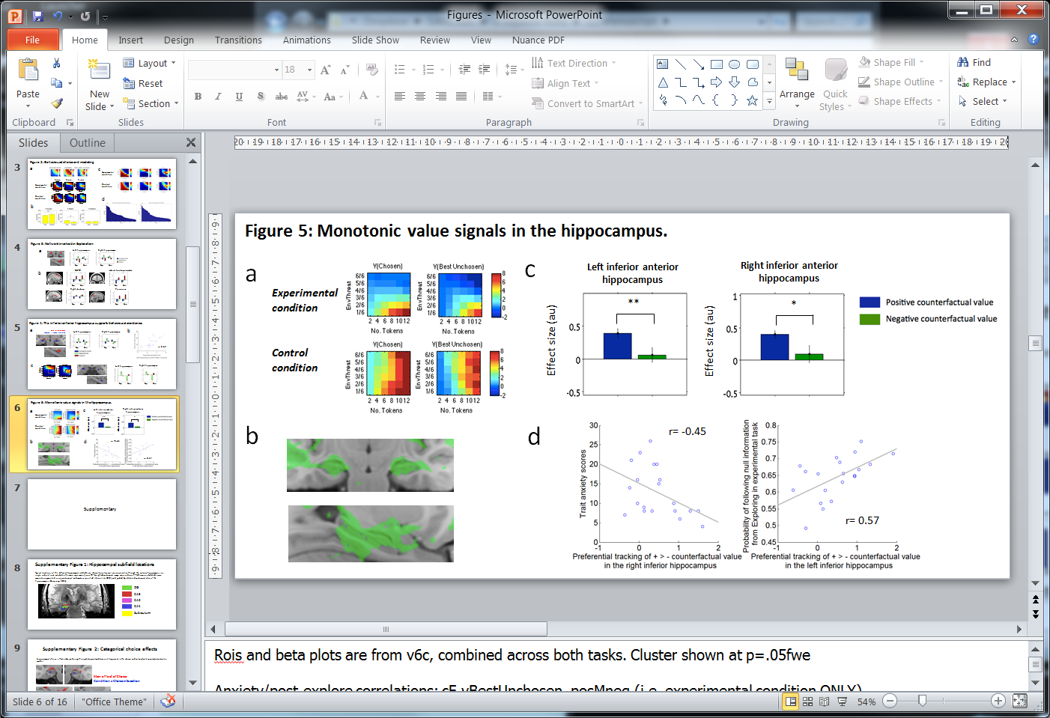
Issue 1: HPC tracking of V(BU) is +/-?
Issue: The issue was that the hippocampus shows negative tracking of V(Best Unchosen), but Figure 5c shows positive betas
Explanation: The betas in the original Fig 5c and Fig 5d relate to effect sizes (i.e. negative betas had been flipped)

Slide 3
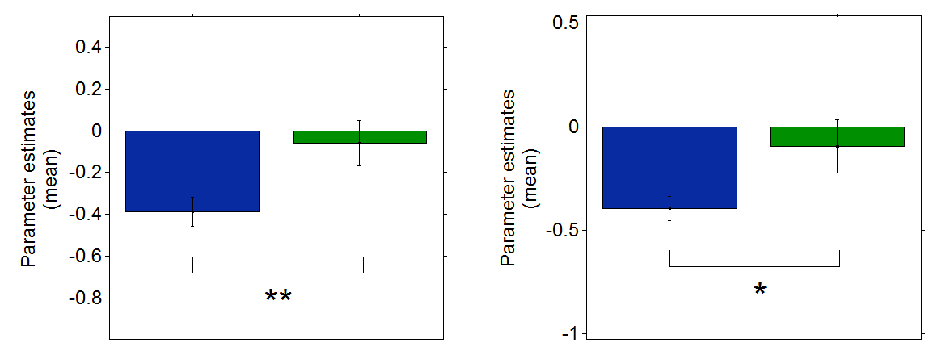
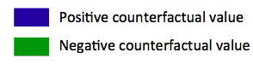
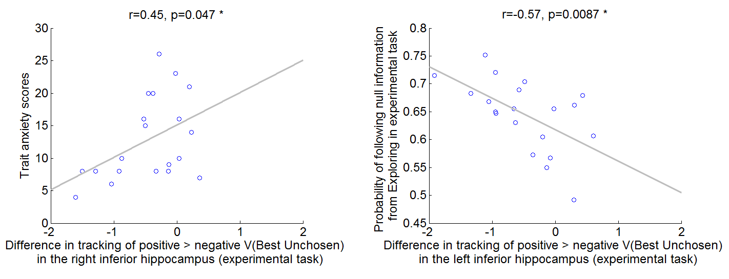
Solution to Issue 1
It may be easier to understand if we keep things in terms of effect sizes (and flag this very clearly in the manuscript/Figure). This may be particularly helpful for understanding Figure 5d (correlation between choice/anxiety and the difference in vBU +/- tracking.
Alternatively, presented in raw betas:
Left inferior anterior hippocampus
Right inferior anterior hippocampus
Figure 5c
Figure 5d
Notes:
Note: Figure 5c, vBU + vs – is presented. If we restrict this to the experimental task only, nothing changes.

Slide 4
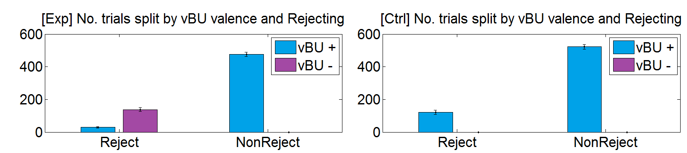
Issue 2: HPC tracking of V(BU) is +/-?
There is a difference in HPC tracking of V(BU)+ versus V(BU)-
All trials with negative counterfactual value are trials in which subjects have rejected
Thus, the effects in Fig 5c and 5d, describing a difference in tracking of + vs – V(BU) could actually be a difference in tracking of V(BU) on Rejected vs Non-Rejected trials
Figure 5c (original)

Slide 5
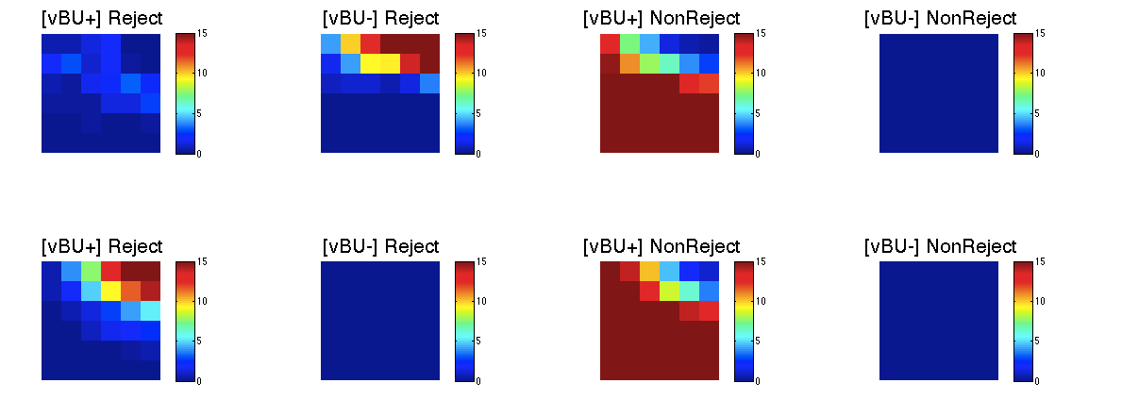
Further distribution of trials by V(BU) valence and Rejecting/Non-Reject choices
Exp
Control

Slide 6
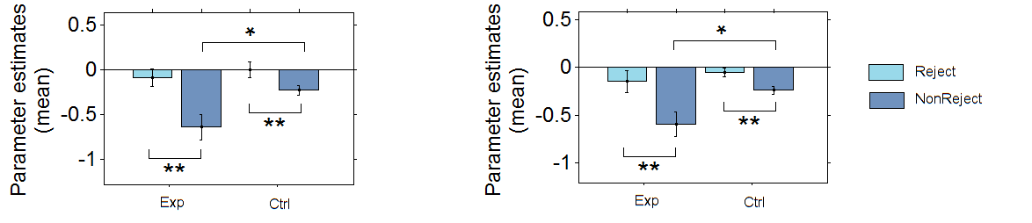
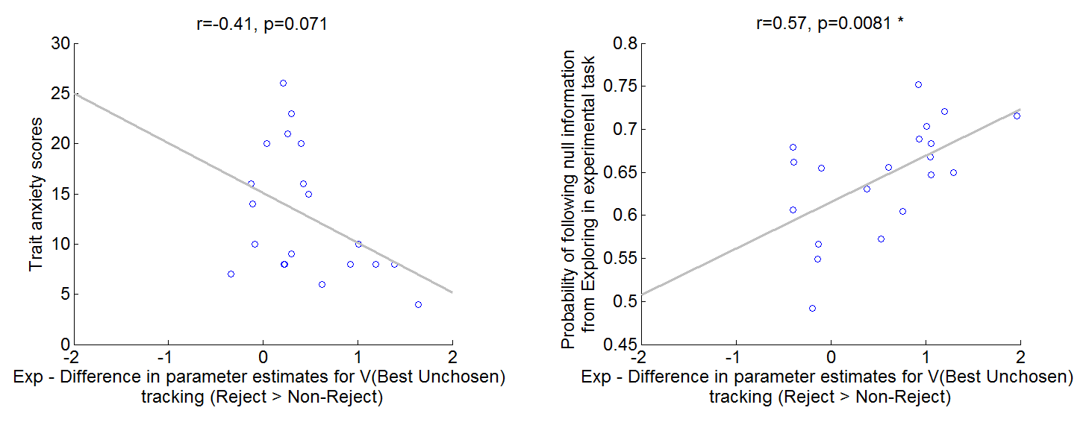
Are the observed effects re V(BU) +/- actually driven by differences in V(BU) on Rejected vs Non-Rejected trials?
Left inferior anterior hippocampus
Right inferior anterior hippocampus
Notes:
Task x Choice 2x2 ANOVAs
Left HPC:
ME Task: f(1,19)=5.45, p=.03
ME Choice: f(1,19)=23.42, p<.001
TxC: f(1,20)=2.09, p>.1
Right HPC:
ME Task: f(1,19)= 3.63, p=.072
ME Choice: f(1,19)= 28.02, p<.001
TxC: f(1,19)=3.24, p.088

